Slide 1
Proposal Document - Analysis

Slide 2
What is this proposal document?
This is how you research the "Problem" to show you have fully explored the problem and all its facets
THEN you give a design based on your research.

Slide 3
Title page
"Proposal for INSERT COMPANY NAME HERE"
With your name, learner number, "Occupational Specialism, maybe a nice picture linked to the theme of scenario too.

Slide 4
Content page
This has to be an auto generated contents page
Make sure all titles and sub titles in the document are formatted as "headings"

Slide 5
Organisation overview
Give a description of the business that the scenario is about.
Who are they as a business?
What do they do?
What are they looking for

Slide 6
Problem Overview
Write detailed description of your understanding of the problem. The main problems with their current system
You should talk about the impact these problems are putting on the business.
Give a description of what the problem is with the current system
DO NOT TALK ABOUT how you will solve it.

Slide 7
Scope
Make a statement around how big the scope could be for the scenario, but explain how you plan to limit your scope and why.
e.g. Doctors appointment system: Potentially enourmouse scope looking at parental consent, linking family members, authorising users to view appointment and make appointments for others … all becomes too big. So my narrow focus is on the one to one relationship of an adult (18+) who is tech savy managing their own appointments only. This ensures the scope isn't too big. …. This is a very short example, with not the proper fleshing out of detail.

Slide 8
User groups
Identify what you feel are the groups of users that you think will use the system.
Explain how you have identified them
Briefly talk about how you think they will make use of the system (what sorts of things are they likely to do. With the system)
Make sure to state things like: Likely age ranges, employment status, technology ability level. Use this information to help you when working on User stories and empathy maps.
Gender should only be mentioned IF it is really important to the scenario (it rarely is)

Slide 9
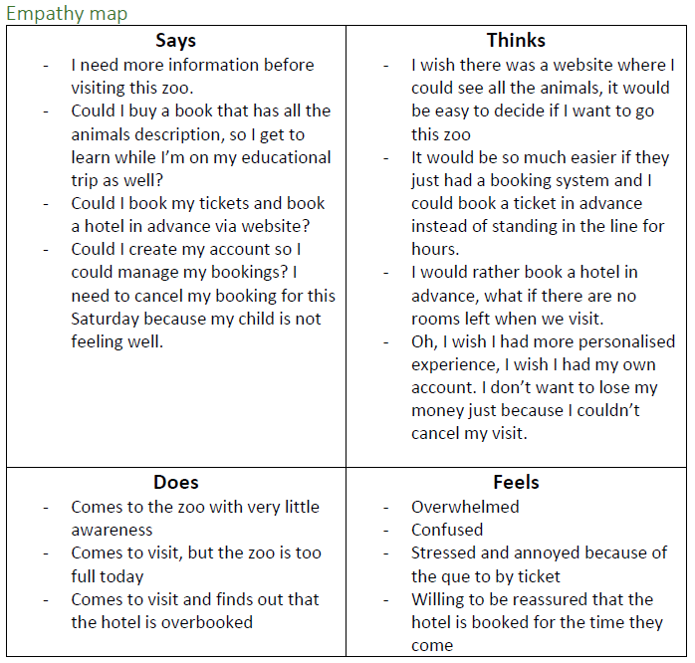
Empathy Maps
This is a table of the problems and
needs:
Shows a process of exploring what
Customers / users think and feel about
the current solution

Slide 10
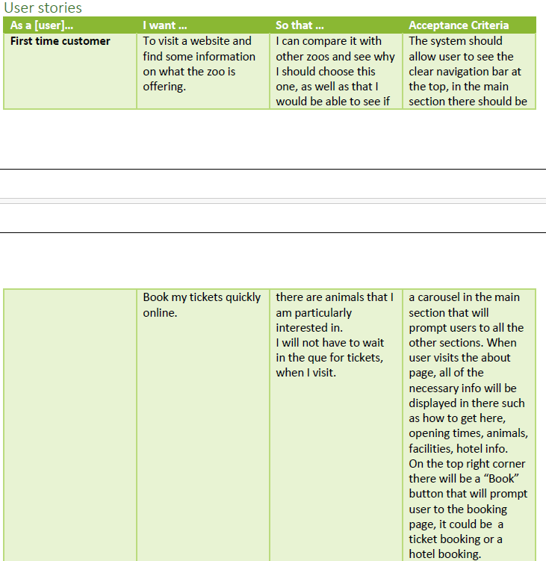
User stories
For each of the groups of
users you need to create a user story which explores
the things that they want to
do, why they want to do it
and the
"Acceptance Criteria"
they will need.

Slide 11
Laws / Guidance / Legislation
Explore what laws and guidance that the identified business have to operate under
Look at the laws and legislation that the business would have to work under
Look at other laws / legislation that will impact your system you will develop
For all of these.. What is the impact on your project? What will you do to adjust / mitigate these impacts?

Slide 12
Alternative systems
Look at / research other systems that are available for the same thing (sales platforms etc)
If you are struggling look at excel as an option.
For each of the systems (ideally 3 to 5):
What does the system do well (that solves their problems)
What does the system fail to do for them
What things will you take forward to your design (ideas you can steal) and why

Slide 13
Risks
Start with security risks: What risks exist? How can you defend or prevent them being an issue.
What sort of risks might also come up? That could impede you completing the project
You need to make sure you discuss how you will mitigate these risks.

Slide 14
Decomposition
"break down" the problem as you see it right now, into a diagram
This will be a sort of diagram of the structure of the website you are going to build the features you are going to have on each page.

Slide 15
User acceptance criteria
This should be a list of things that the users (each of the groups you identified) will need to see / experience / feel etc To accept the system.
This could be things like
"Clear an obvious navigation bar"
"Fast loading times for each of the pages"
"Clear instructions on each page for booking"
These should be grouped by each of the user groups you have identified

Slide 16
functional and non-functional requirements
Functional requirements are things the system should do (focus on business needs):
Allow users to register
Once logged in, direct users straight to their profile page
Allow booking of events in advance
Non-functional requirements are how the system should do things:
Store passwords using sha256
Each page should load in 2 to 5 seconds

Slide 17
Key Performance Indicators (KPI)
Things that will help to indicate the success of the project from a business perspective:
Should be categorised where possible.
Examples could include:
"Improved trust pilot reviews"
"visitor satisfaction rate"
"Numbers of repeat visitors"
"page load time"
"traffic by source increase in all sources"

Slide 18
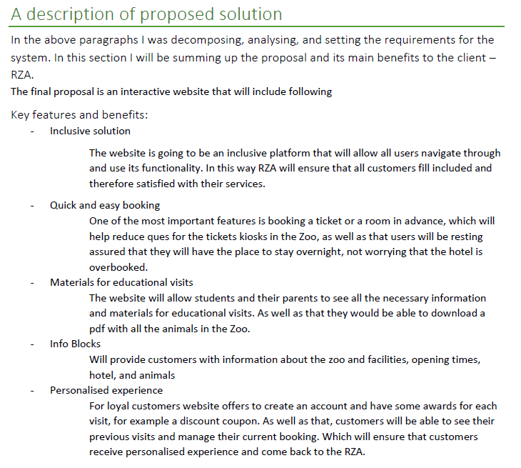
Description of proposed solution
Give an overview of what you solution will be

Slide 19
Tips
Justify EVERYTHING, the more you tell me your reasoning and thought process, the better.
Keep a thorough and accurate list of websites you visited WITH TIME AND DATE
Other than the first couple of headings and the last couple, the rest should be NOT in this order in this powerpoint.

